Slide 1
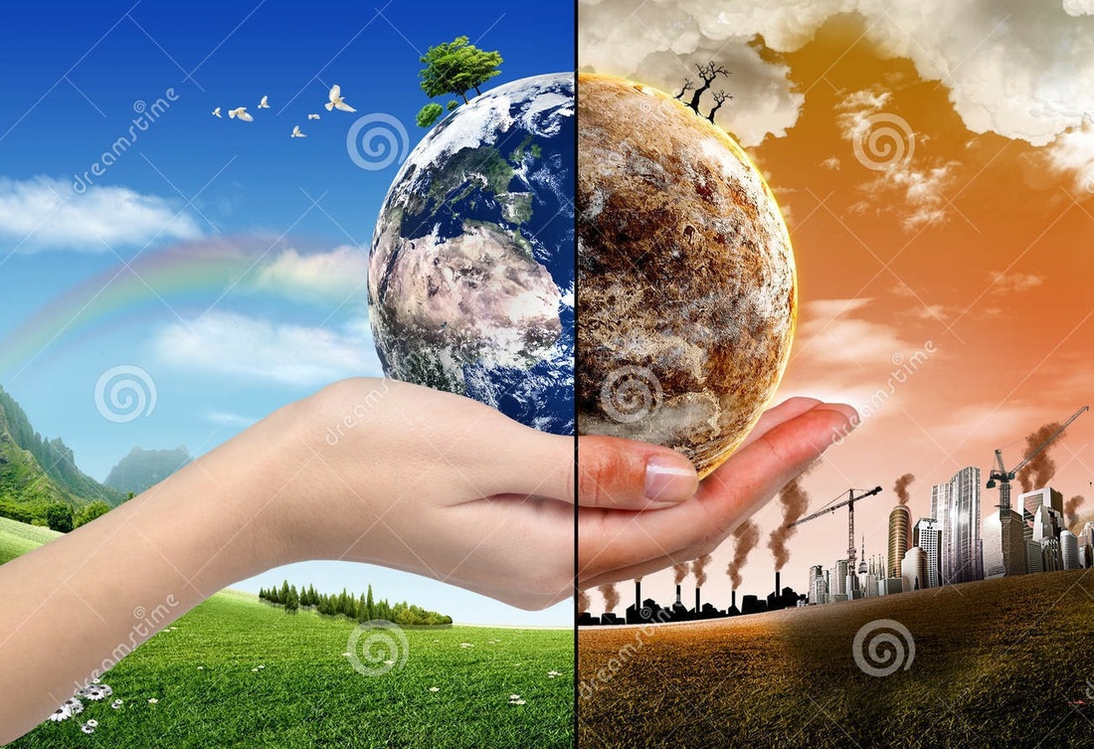
Globalization and the End of the World
David M. Boje, Ph.D.
New Mexico State University
Guest of Alessio Sartore, Ph.D.
IULM University of Milan, Italy
Slides & books at http://davidboje.com/Italy

Slide 2
Opener: Threats to Existence of Humanity
Individually, brainstorm list of TEN events that would cause 50 to 90% Human Extinction by end of century
What would cause Human Extinction, defined as undoing of the Human existence?
Get into groups of 5 and make one list of 10 on a poster
For each Human Extinction event, assign a probability from 0 to 100% that this will occur by end of century
How do we reduce the risk of Human Extinction for top 3 events? Add this to your poster

Slide 3
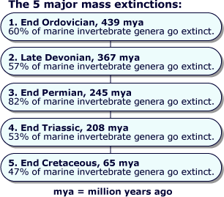

Slide 4
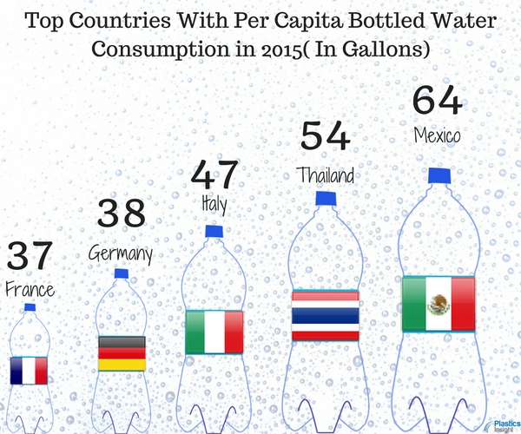

Slide 5
What is 6th Extinction
Sixth Mass Extinction is a massive die-off of plants and animals all across the planet.
Also known as Holocene extinction (mostly caused by HUMANS) or Anthropocene extinction (abrupt enough HUMAN CAUSED EXTINCTION, to be its own epoch)
ANTHROPOCENE is the ongoing extinction event of species during the present event, mainly result of human activity
If current rate of human disruption of BIOSPHERE continues then ½ of Earth higher life forms will be extinct by 2100.
6th Extinction is 10 to 100 times greater than any previous mass extinction
We have unleashed a mass extinction in which many lifeforms won’t exist by end of this century.

Slide 6
6th Extinction
2016 study published in the journal Science also suggests this sixth mass extinction is killing off large ocean dwellers (like sharks, whales, giant clams, sea turtles and tuna) in disproportionately greater numbers than smaller animals.
Deforestation to grow cows, logging for construction
Too many species die off sets a domino effect in motion
Invasive species threaten plants
Extinction rates for mammals, birds, amphibians & fish have all are 20 times expected rates since 1900 (rate for reptiles is 8 to 24 times above expected).
Biodiversity crisis we are in NOW, is real!
Human species is reliant on healthy ecosystems for food, water and air.
Its all about over-exploitation of Planetary Resources for Economic Gain, so 8 billionaires can own ½ of all wealth in PERVERTED GAME OF MONOPOLY

Slide 7
Anthropogenic (Human Impact on Environment)
Means changes to biophysical environments and ecosystems, biodiversity, and natural resources, caused by Humans from:
Global warming from bigger CO2 footprints increase in GLOBALIZATION, reduces Planet’s carrying capacity for life, plus
Environmental degradation & habitat destruction by overconsumption of natural resources (US consumes 30% of Earth-resources; 1/3rd Earth-Resources already gone), goods designed for obsolescence (e.g. FAST FASHION produces 15.1 tons textile & 12.8 tons thrown out); only 1% of all goods purchased still in use in 6 months), consuming more protein than needed, plus pollution in GLOBALIZATION leads to
Ocean acidification
Overfishing & Deforestation
Mass extinction
Biodiversity loss
Ecological crises
Global arms race, resulting in nuclear & chemical annihilation

Slide 8
OMNICIDE = human extinction by human action
Nuclear warfare
Biological warfare
Global anthropogenic ecological catastrophe by humans consuming and producing globalization causing:
Global warming by CO2 & Methane (ice free poles, melted glaciers)
Ecosystem collapse (ocean acidification, coral reef dies, pollution of soil, air, & water)
Exhausting natural resources of planet (e.g. deforestation from globalization pressures)
Biodiversity collapse (fewer plants, animals, & insects) from overpopulation; to save species is to SAVE OURSELVES
Release of a Pandemic or defective gene
Advanced AI, self-replicating nanobots (gray goo) out-of-control, ecophagy (eating the environment), biotech annihilates human race
Decline in pollinators (no bees to pollinate our crops)

Slide 9
Globalization
Rich western countries are depleting planet’s resources & destroying Earth-ecosystems at accelerating rate.
We build highways across Serengeti plain (Tanzania) to get more rare earth minerals for our iPhones, MacBook & GPS. We grab all the fish from the sea, wreck the coral reefs and put carbon dioxide into the atmosphere.
We have triggered a major extinction event

Slide 10
What is Globalization doing to End the World in your children’s children’s lifetime?
Results of focus groups so far, when asked: What was #1 Extinction threat that can bring about end of the world?
Donald J. Trump
Climate Change
Nuclear War
Pandemic
Introduction of Exotic Species
Deforestation/Habitat Loss
Pollution
Non-human causes →Asteroid, Alien Invastion, etc.
Extinction Event: causes drastic change in # of species in short period of geologic time

Slide 11
[In TRUMPLAND] there is a massive amount of economic anxiety. Unemployment is much too high, wages and income are too low, millions of Americans are struggling to find affordable health care and the gap between the very rich and everyone else is growing wider… Many of our people are physically exhausted as they work the longest hours of any industrialized country and have far less paid vacation time than other major countries

Slide 12
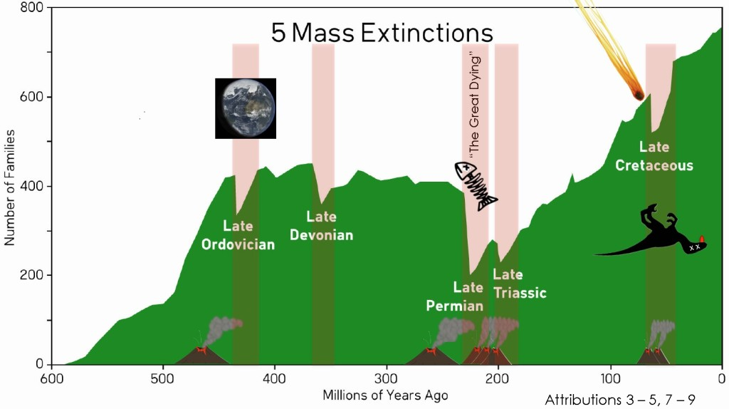

Slide 13
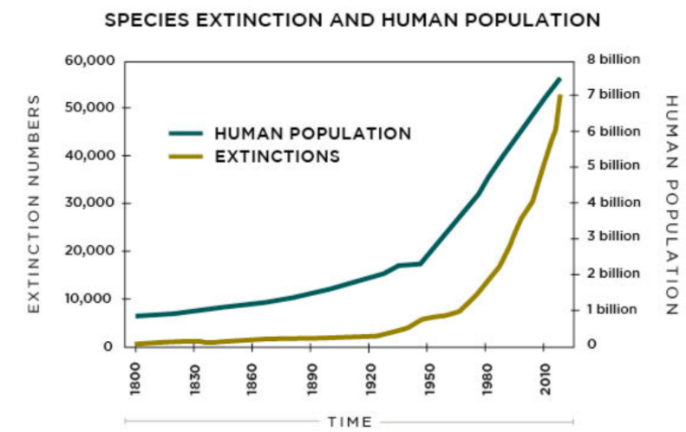
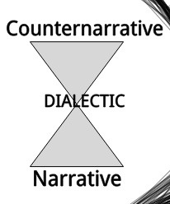
Western Narrative and Counternarrative is DIALECTIC
“We intend to offer a counter-narrative to those accounts of specific species extinction … that places humanity’s ways of organising at the core and recognises that only fundamental re-appraisal of (western) humanity’s current taken-for-granted narratives offers any hope for biodiversity and sustainability” (Gray & Milne, 2018)
“sustainability [will] hasten humanity’s extinction; whilst modernity, too, seems intent upon achieving this very aim through a destruction of ecology in the name of self-congratulatory accounts of human progress” (Gray & Milne bracket mine)
For every Narrative there is at least one counternarrative!
Notes:
Gray, R., & Milne, M. J. (2018). Perhaps the Dodo should have accounted for human beings? Accounts of humanity and (its) extinction. Accounting, Auditing & Accountability Journal, (just-accepted), 00-00.
Living Planet Index (LPI) argues that between 1970 and 2010 terrestrial species have declined by 39%; freshwater species by 76% and marine species by 39%. 82%
Scott, J. M, (2008) Threats to Biological Diversity: Global, Continental, Local. Shifting Baselines and
New Meridians: Water, Resources, Landscapes, and the Transformation of the American West (Summer
Conference, June 4-6). http://scholar.law.colorado.edu/water-resources-and-transformation-of-American-West/15

Slide 14
How do we reduce the risk of Human Extinction?
From my discipline of storytelling, We need to:
Deconstruct Globalization Myths
Develop Counternarratives to the Myths
Do ONTOLOGICAL PROCESS research into INDIGENOUS WAYS OF KNOWING, that has SURVIVED
Develop Ethical Corporate PRAXIS of PROCESS that is Intelligent Action
Notes:
If time remains, answer: Why does New Zealand have highest youth suicide rate in the developed world? On poster, Top 3 reasons
References
1. IPCC (2014). Climate Change 2014: Mitigation of Climate Change . EXIT Contribution of Working Group III to the Fifth Assessment Report of the Intergovernmental Panel on Climate Change [Edenhofer, O., R. Pichs-Madruga, Y. Sokona, E. Farahani, S. Kadner, K. Seyboth, A. Adler, I. Baum, S. Brunner, P. Eickemeier, B. Kriemann, J. Savolainen, S. Schlömer, C. von Stechow, T. Zwickel and J.C. Minx (eds.)]. Cambridge University Press, Cambridge, United Kingdom and New York, NY, USA.
2. FAO (2014). Agriculture, Forestry and Other Land Use Emissions by Sources and Removals by Sinks.(89 pp, 3.5 M, About PDF) EXIT Climate, Energy and Tenure Division, FAO.
3. IPCC (2014): Climate Change 2014: Synthesis Report. Contribution of Working Groups I, II and III to the Fifth Assessment Report of the Intergovernmental Panel on Climate Change.(80 pp, 4.2 M, About PDF) EXIT [Core Writing Team, R.K. Pachauri and L.A. Meyer (eds.)]. IPCC, Geneva, Switzerland, 151 pp.

Slide 15
Deconstructing Myths Preventing New form of Globalization

Slide 16
What is a hidden cost? What to do about it?
Hidden Cost defined as UNSEEN costs hidden behind official accounting/budget/financial NARRATIVES & GREENWASHING NARRATIVES
COUNTER ACCOUNTING → defined as process of identifying & reporting HIDDEN COSTS of organizations’ significant economic, environmental & social Problems, covered over by PANGLOSSIC NARRATIVE
HOW? Do QUALIMETICS (qualitative/quantitative/financial) research into external or unofficial sources (expert reports, research papers, online journals, studies from NGOs, government publications, legal proceedings, etc.) in view of verifying, to produce liberatory COUNTER ACCOUNTING with EMANCIPATORY POTENTIAL
Notes:
Boiral, Oliver. (2013). Sustainability reports as simulacra? A counter-account of A and A+ GRI reports. Accounting, Auditing & Accountability Journal, 26(7), 1036-1071.

Slide 17
How would you prevent or manage hidden costs of Globalization?
Hidden Cost of Globalization Climate Change? https://www.epa.gov/ghgemissions/global-greenhouse-gas-emissions-data
Hidden Cost of Trump’s assault on EPA? https://www.youtube.com/watch?v=y-sQXpX0lWA
Hidden Cost of WENDY’s slave labor tomatoes see https://www.youtube.com/watch?v=pUv2X_f_kK4 RAPE IN THE FIELDS or this one Hidden Cost of Internet - https://www.youtube.com/watch?v=GX8sOrz_-Fg
Hidden Cost of Bottled Water https://www.youtube.com/watch?v=yboLgZPCAR8
HIDDEN Cost of Stuff https://www.youtube.com/watch?v=9GorqroigqM
Hidden Cost of Hamburger (fastfood https://www.youtube.com/watch?v=ut3URdEzlKQ&t=123s
Hidden Cost of Big Mac https://www.youtube.com/watch?v=wp6YrHzcwhA&t=41s
Hidden Cost of War – Bernie Sanders https://www.youtube.com/watch?v=8uoF22dc6QI&t=101s
Hidden Cost of Milk - https://www.youtube.com/watch?v=72004w2Nsfs
Hidden Cost of Light Pollution https://www.youtube.com/watch?v=P2JQFyFcbRU
Hidden Cost of Starbucks https://www.youtube.com/watch?v=-ppkVx0fRPY&t=4s
Hidden Cost of Outsourcing https://www.youtube.com/watch?v=pMMqB5iqudY
Hidden Cost of Coca Cola & Pepsi https://www.youtube.com/watch?v=YgrAtDRj_mQ
Hidden Cost of Conflict Minerals - https://www.youtube.com/watch?v=_mbBzJDcrEY

Slide 18
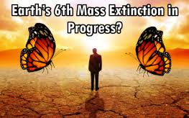
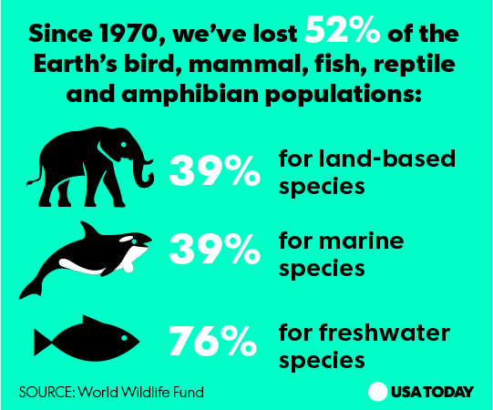
Pause for Q&A

Slide 19
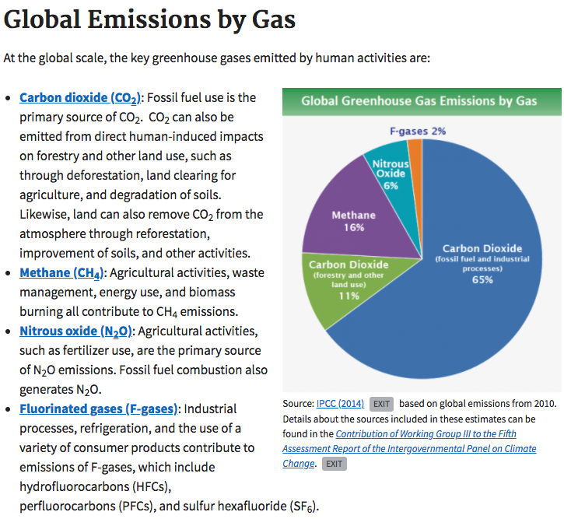
Notes:
https://www.epa.gov/ghgemissions/global-greenhouse-gas-emissions-data
References
1. IPCC (2014). Climate Change 2014: Mitigation of Climate Change . EXIT Contribution of Working Group III to the Fifth Assessment Report of the Intergovernmental Panel on Climate Change [Edenhofer, O., R. Pichs-Madruga, Y. Sokona, E. Farahani, S. Kadner, K. Seyboth, A. Adler, I. Baum, S. Brunner, P. Eickemeier, B. Kriemann, J. Savolainen, S. Schlömer, C. von Stechow, T. Zwickel and J.C. Minx (eds.)]. Cambridge University Press, Cambridge, United Kingdom and New York, NY, USA.
2. FAO (2014). Agriculture, Forestry and Other Land Use Emissions by Sources and Removals by Sinks.(89 pp, 3.5 M, About PDF) EXIT Climate, Energy and Tenure Division, FAO.
3. IPCC (2014): Climate Change 2014: Synthesis Report. Contribution of Working Groups I, II and III to the Fifth Assessment Report of the Intergovernmental Panel on Climate Change.(80 pp, 4.2 M, About PDF) EXIT [Core Writing Team, R.K. Pachauri and L.A. Meyer (eds.)]. IPCC, Geneva, Switzerland, 151 pp.

Slide 20
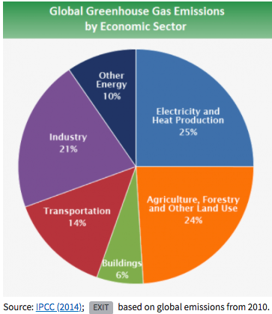
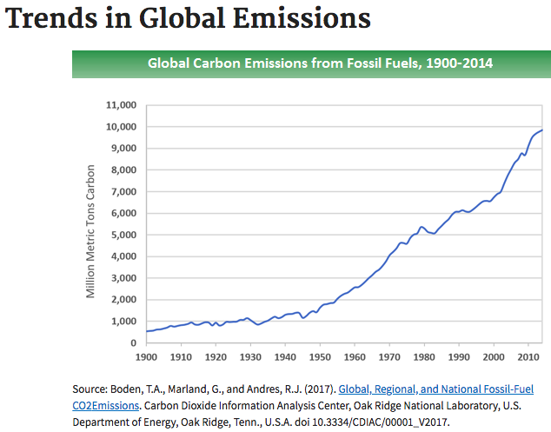
Hidden Costs of Globalization
Notes:
https://www.epa.gov/ghgemissions/global-greenhouse-gas-emissions-data

Slide 21
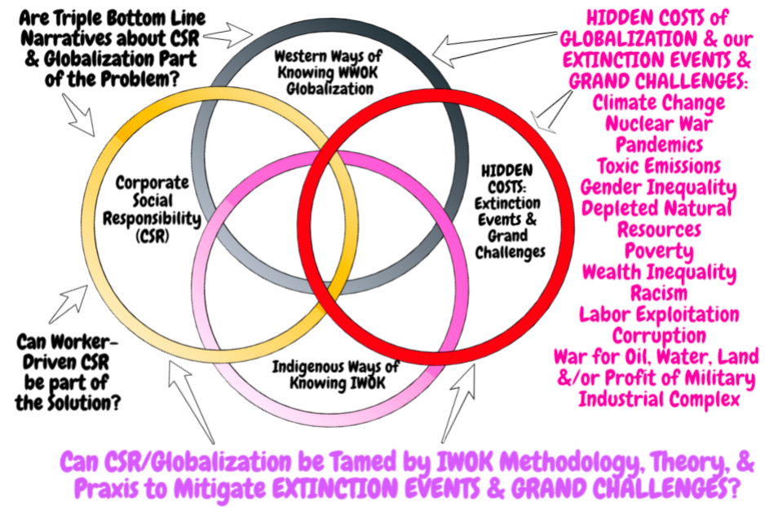

Slide 22
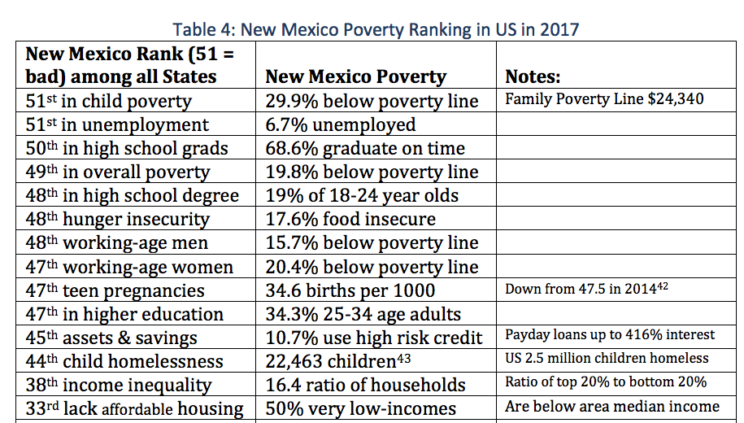
Notes:
https://www.huffingtonpost.com/rep-bernie-sanders/what-can-we-learn-from-de_b_3339736.html?utm_hp_ref=tw
Denmark is a small, homogenous nation of about 5.5 million people. The United States is a melting pot of more than 315 million people. No question about it, Denmark and the United States are very different countries. Nonetheless, are there lessons that we can learn from Denmark?
In Denmark, social policy in areas like health care, child care, education and protecting the unemployed are part of a “solidarity system” that makes sure that almost no one falls into economic despair. Danes pay very high taxes, but in return enjoy a quality of life that many Americans would find hard to believe.
Health care in Denmark is universal, free of charge and high quality. Everybody is covered as a right of citizenship. The Danish health care system is popular, with patient satisfaction much higher than in our country. In Denmark, every citizen can choose a doctor in their area. Prescription drugs are inexpensive and free for those under 18 years of age. Interestingly, despite their universal coverage, the Danish health care system is far more cost-effective than ours.
In Denmark, more than 75 percent of the people are members of trade unions. In America today, as a result of the political and economic power of corporate America and the billionaire class, we are seeing a sustained and brutal attack against the economic well-being of the American worker.

Slide 23
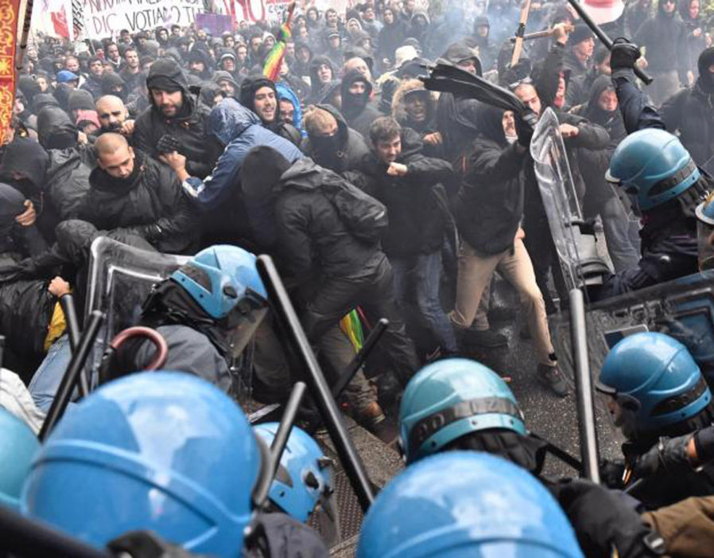
How is Globalization Affecting Italy’s Youth?
November 2016: Florence erupts in violence as anti-Renzi protesters clash with riot cops. Hooded youths attacked lines of cops protecting embattled prime minister Matteo Renzi, who was in the city for crunch political talks.
Notes:
https://www.express.co.uk/news/world/880113/Italy-crisis-European-Union-budget-Jyrki-Katainen-Paolo-Gentiloni

Slide 24
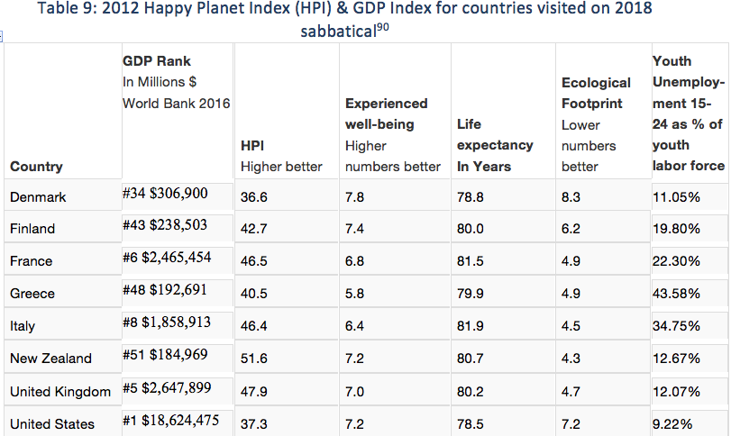
Notice Italy’s Youth Unemployment
Notes:
https://data.oecd.org/unemp/youth-unemployment-rate.htm

Slide 25
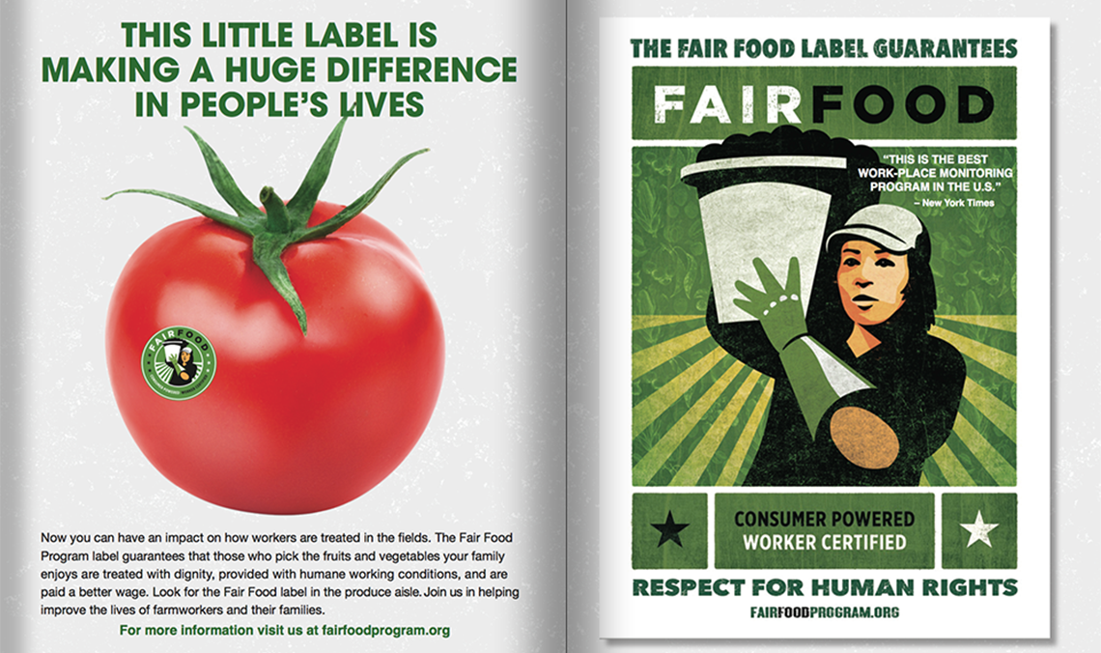
Fair Food Program — the unfolding story of increasing compliance through the constant back and forth of audits, investigations, and corrections — over the course of all six seasons of the Program’s operation

Slide 26
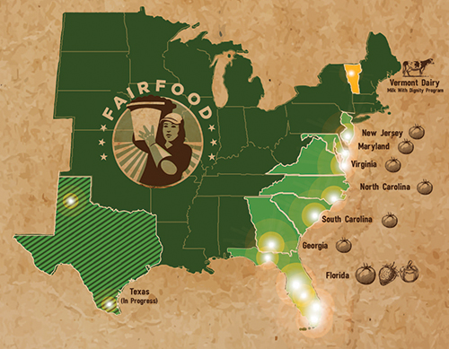
Worker-Driven “Corporate Social Responsibility’ ETHICS Example

Slide 27
Sociomateriality of Modern-Day Slavery In USA
"The bosses carried weapons. They scared me. I never knew where I was. We were transported every fifteen days to different cities. I knew if I tried to escape I would not get far because everything was unfamiliar. The bosses said that if we escaped they would get their money from our families."
--Congressional testimony of Maria, trafficking survivor from Mexico
https://www.commondreams.org/views/2010/06/19/driven-globalization-todays-slave-trade-thrives-home-and-abroad

Slide 28
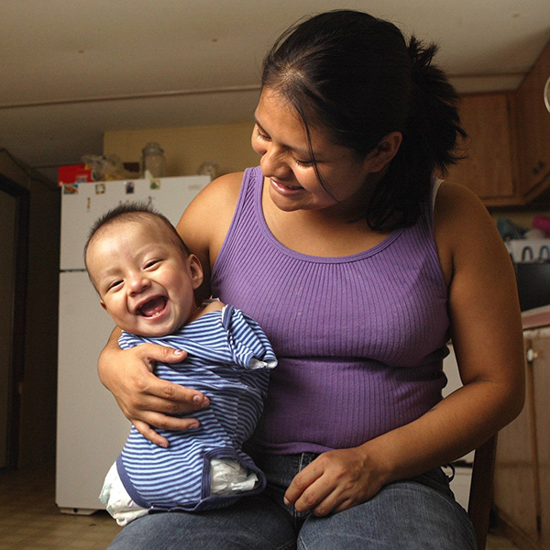
What are the Chemical Working Conditions”
Carlos Candelario, known as Carlitos, was born Dec. 17 without arms or legs.
At the entrance to the field where the mother worked, there is a list of some 30 chemicals used on the crops during the year
This is sociomateriality of storytelling.
Its an embodiment and dismemberment of the next generation
http://www.mypalmbeachpost.com/news/carlitos/

Slide 29
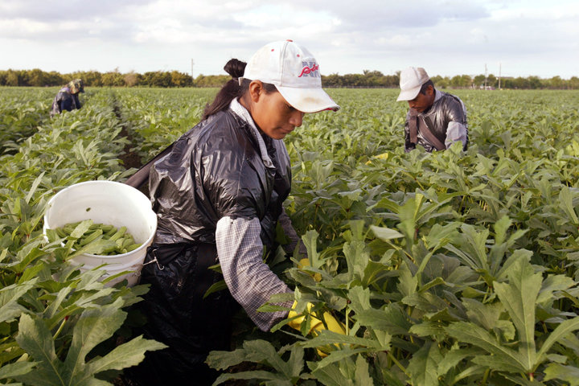
Five Female Migrant Workers Awarded $17 Million In Rape, Harassment Case
The women claim their bosses assaulted them on the job.
By Laura Bassett

Slide 30
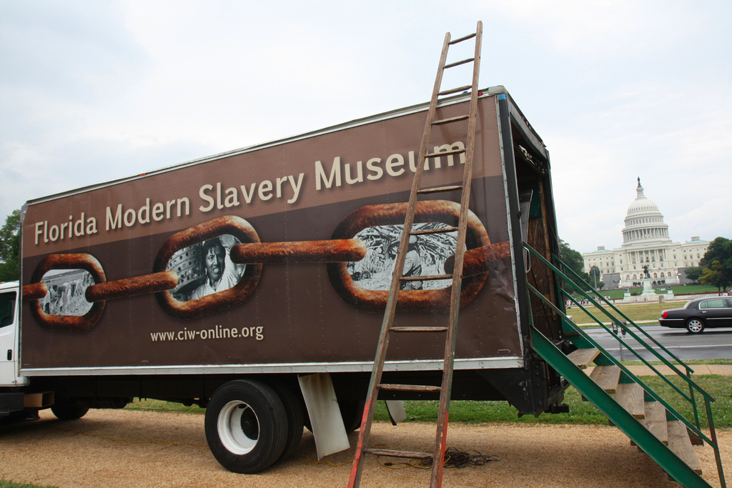
How can you help end global slavery supply chain?
Worker education,
Worker-driven alliances, &
System of alliance of consumers, brands, growers, and workers
This creates revolutionary changes

Slide 31
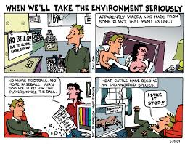
Pause for Q&A
Notes:
See Vinnarei & Laine (2017) The moral mechanism of counter accounts: The case of industrial animal production. Accounting Organizations and Society. Vol. 57: 1-17.

Slide 32
Why is Youth Unemployment high in Italy?
26% if unemployed youth have no work experience
Takes 51 months on average after graduating to find job
Does Italy’s University System increase Youth Unemployment? (courses not practical; few internships, graduates have more skill than the labor market wants,…)
What are hidden costs of Youth Unemployment? (e.g. brain drain as graduates leave Italy to find work)
Notes:
https://en.wikipedia.org/wiki/Youth_unemployment_in_Italy

Slide 33
GDP is not measure of anything relevant to ecology
The GDP rankings of nations is “ecologically irrelevant, since they do not account for the possible absolute increases in material flows from the ecosphere to the economy” (Milne & Gray, 2013: 23).

Slide 34
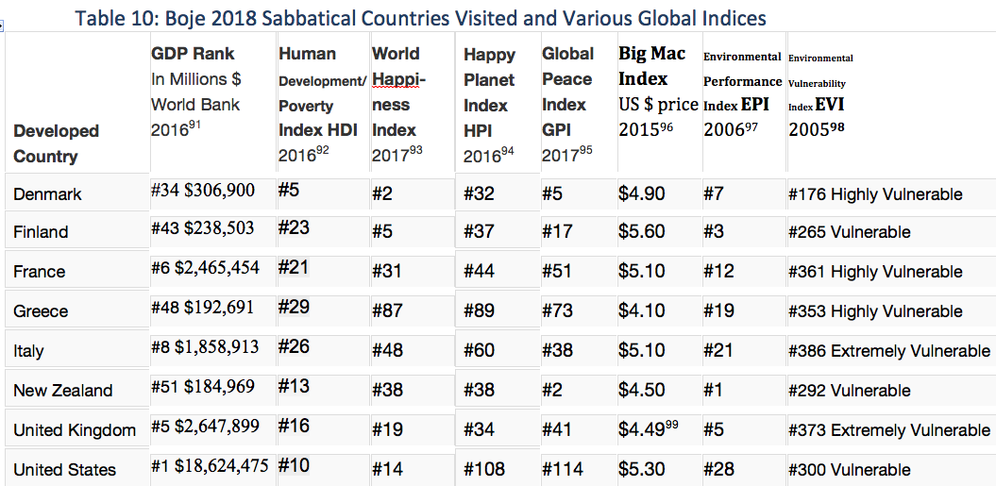
Various Globalization Indices on Boje’s Sabbatical

Slide 36
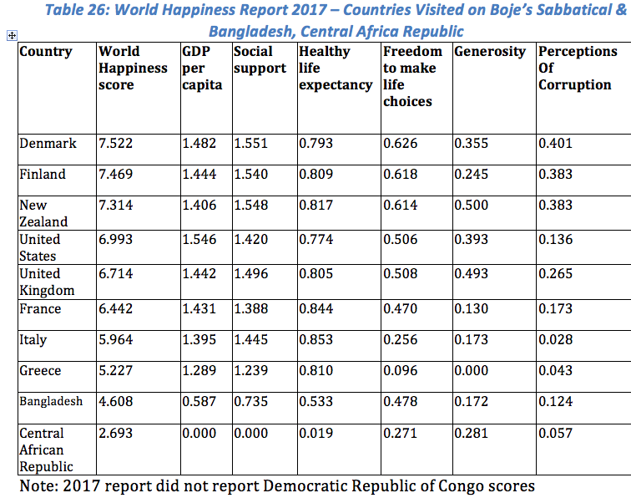
Why do People live so long in Italy, & why is corrouption so high?

Slide 37
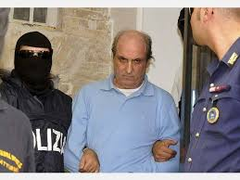
Mani pulite ‘Clean Hands’
Judge Antonio Di Pietro investigation of political corruption of 5,000 public figures (industrial leaders & about 1/2 Italian Parliament)
Result: demise of First Republic, and 4 of its parties, suicide of some industrial and political leaders, 400 city/town councils dissolved
When Silvio Berlusconi won elections, his brother Paolo admitted corruption crimes, and Berlusconi’s party tried to pass law so Paolo would not go to jail.
Law timed during 1994 Football World Cup, betting that if Italy won, then with all the celebrations, no one would notice the new law
But Roberto Baggio shot high on last penalty & news showed images of hated, corrupt politicians getting out of jail
Public enraged; the images of Francesco De Lorenzo, former minister of Health, were especially striking, since the general public perceived stealing money from hospitals an especially hateful act.

Slide 38
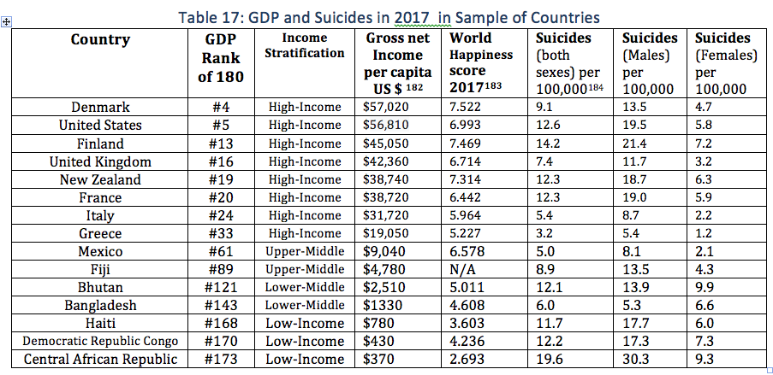
2015 in New Mexico, Whites and American Indians had the highest rates of suicide — 32.5 and 25.2 deaths per 100,000 persons, respectively.
For Whites, the suicide rate was highest among those 35 years and older
For American Indians, the rate was highest among those younger than 35 years
IN ITALY SUICIDE RATE IS LOW

Slide 39
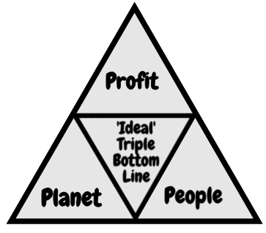
What is Globalization?

Slide 40
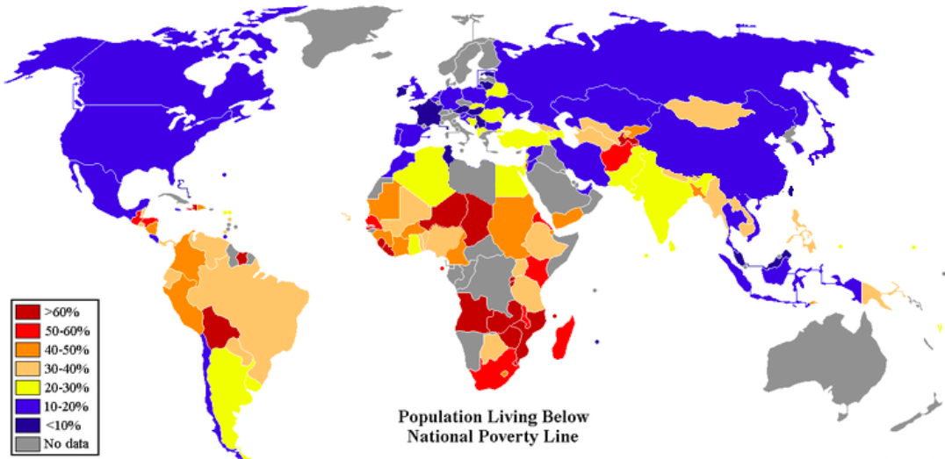
Purchasing Price Parity POVERTY LINE GLOBALLY
Notes:
CIA World Fact-book map

Slide 41
Criticisms of Poverty Purchasing Price Parity (P4)
P4 $50 US basket of goods in supermarket, used to determine poverty rates across countries, now poverty line is set by World Bank committee at $1.90 a day
1776 Adam Smith argued poverty is inability to afford commodities necessary to support life and whatever the custom of a country’s lowest order people
1964 US Republicans endorsed LBJ’s concept of RELATIVE POVERTY
2008, the WB revised PPP (due to inflation) of $1.25 a day at 2005 purchasing-power parity(PPP).
2015, the WB updated the international poverty line to $1.90 a day based on PPP calculations of WHAT $1.90 would buy in US supermarket in 2011
CRITICISMS: P4 leaves thinks like healthcare, clean drinking water, nutrition, housing costs, fertile soil to grow crops, safety, and infrastructure out of the standardized food basket of goods

Slide 42
YouTube on Triple Bottom Line
https://www.youtube.com/watch?v=2f5m-jBf81Q
As you watch, write a list of the fallacies, questionable assumptions being made.

Slide 43
Critique of Triple Bottom Line
Assumes 3 bottom lines are EQUAL
Measures exist for PROFIT; disagreement on measures of PLANET and PEOPLE
3BL is Greenwashing narrative used to make it seem like Corporate Sustainability exists

Slide 44
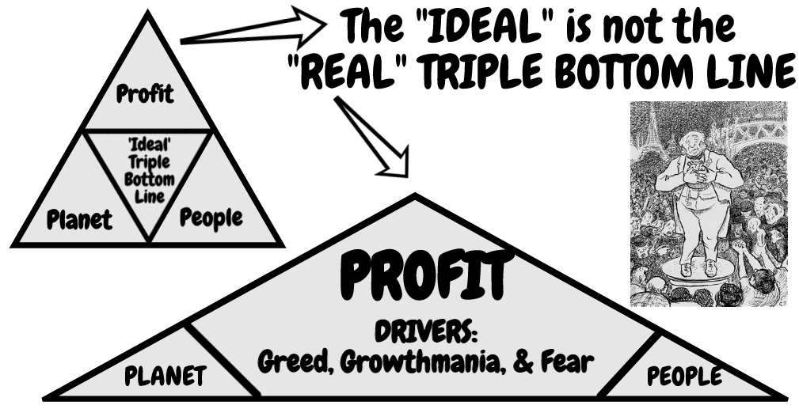
What is Globalization in Reality?
CORE DRIVERS (Greed, Growthmania, & Fear)
MANIFEST: Vicious Spirals of waste, pollution, degradation, depletion, exploitation, poverty, corruption, deprivation, and increasing inequalities of GLOBALIZATION

Slide 45
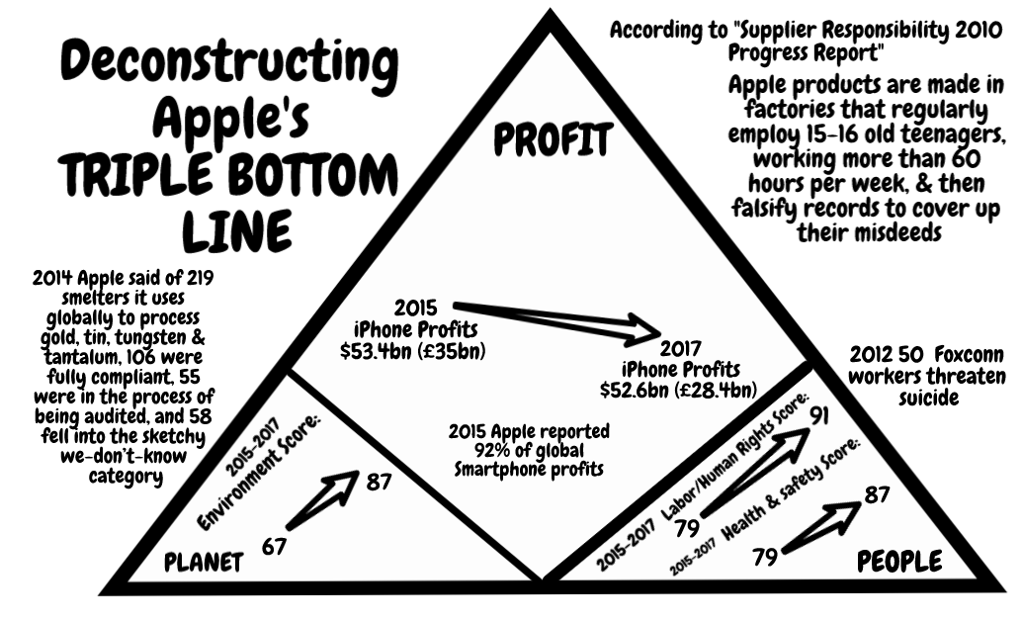
Apple Example

Slide 46
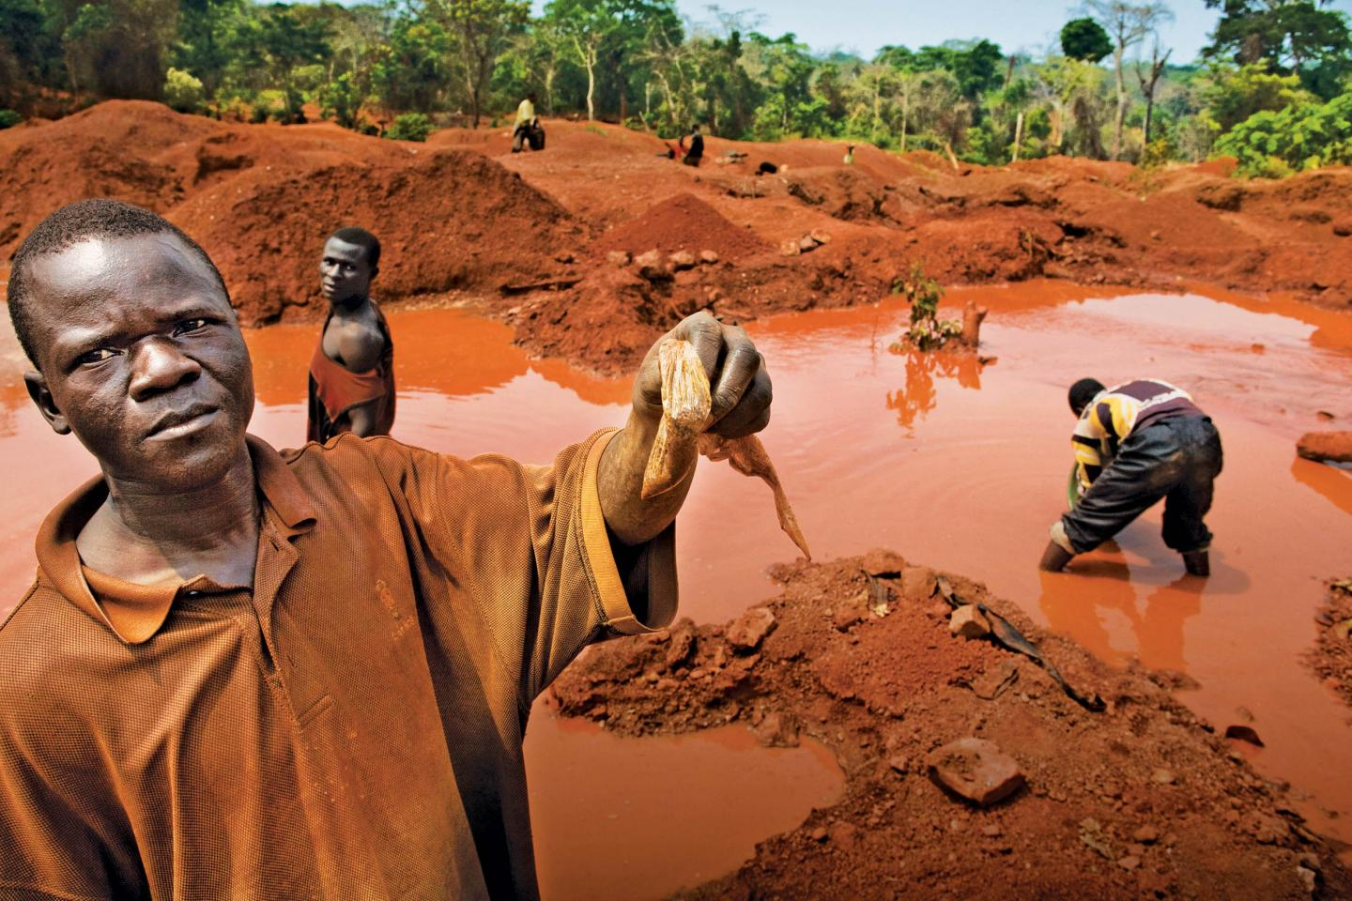
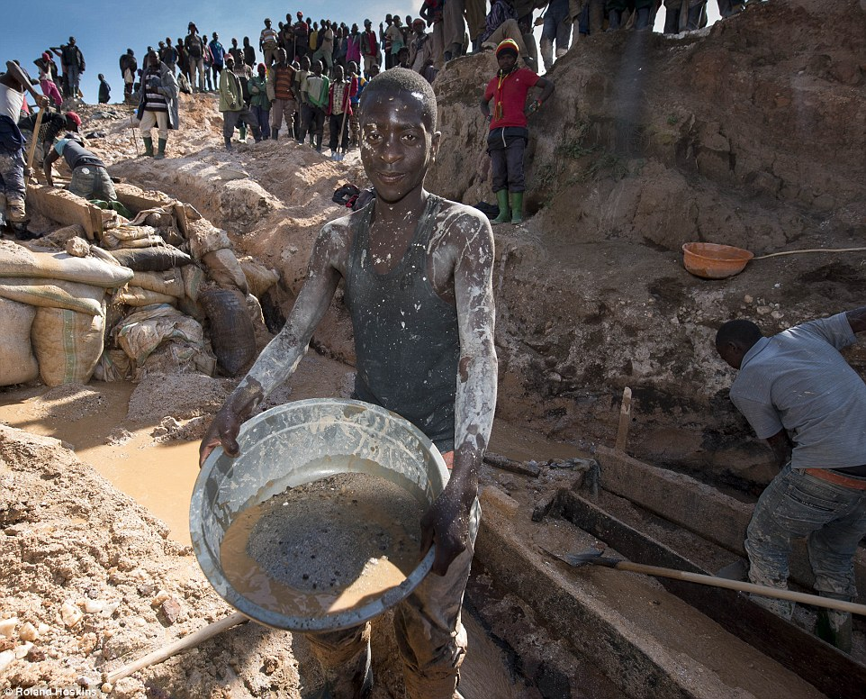
Apple & Democratic Republic on of Congo (DRC)
Notes:
2nd picture http://www.dailymail.co.uk/news/article-3280872/iPhone-mineral-miners-Africa-use-bare-hands-coltan.html

Slide 47
Cell-phone’s 3T’s + Gold
CONFLICT MINERALS
Tin is used as a solder on laptop and cellphone circuit boards
Tungsten makes your cellphone vibrate
Tantalum stores electricity on your cellphone
Gold is used to coat the cellphone wiring

Slide 48
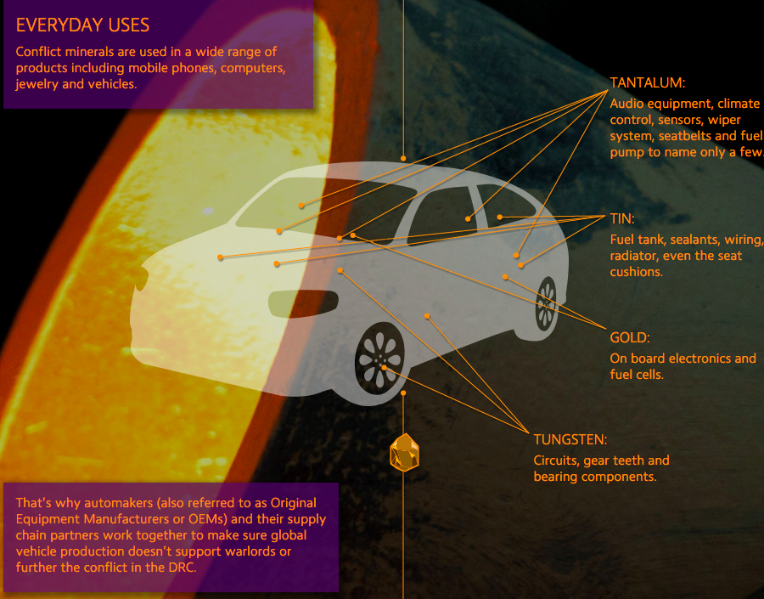
Untold story of 3T’s in Cars

Slide 49
McDonald’s Sustainability Report is McFantasy
McDonald’s reports on water use at its fast food outlets, but not of the 600 gallons of water to make each quarter-pounder
Not reported →large-scale pork produced water pollution (pfisteria-laden waters) in the southeast US causing lesions in fish & fish die-off
Reports on energy use, NOT on 10 calories of energy for every calorie of good produced in unsustainable fast food system
Para. Hawken 2002 as cited in Milne, Markus J. (2013). Phantasmagoria, sustain-a-babbling in social and environmental reporting. Pp. 135-153 in Lisa Jack, Jane Davison, Russell Craig (Eds.) The Routledge companion to accounting communication. NY: Routledge.
Notes:
The report carefully avoids the corporation’s real environmental impacts. It talked
about water use at the outlets, but failed to note that every quarter-pounder requires
600 gallons of water. It talked about recycled paper, but not the pfisteria-laden waters
caused by large-scale pork producers in the southeast. It talked about energy use in the
restaurants, but not in the unsustainable food system McDonald’s relies upon that uses
10 calories of energy for every calorie of good produced. “Sustaining” McDonald’s requires
a simple unsustainable formula: cheap food plus cheap non-unionized labor plus deceptive
advertising = report would tell stakeholders how much it truly costs
society to support a corporation like McDonald’s high profits. An honest. It would detail the externalities borne by
other people, places, and generations.
Hawken (2002)

Slide 50
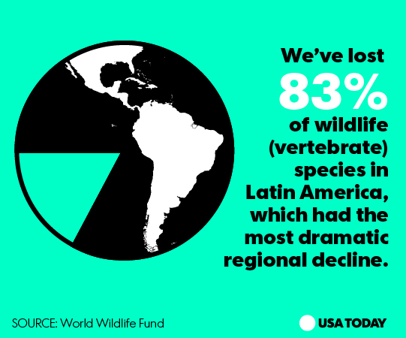
Pause for Q&A

Slide 51
From Milne, 2013
“‘Sustaining’ McDonald’s requires a simple unsustainable formula”:
cheap food + cheap non-unionized labor + deceptive advertising = high profits
(Hawken, 2002, as cited in Milne, 2013: 143, boldness, mine).

Slide 52
Espoused TRIPLE BOTTOM LINE and ‘Actual’ Ethics Behavior
Q: What are the differences?

Slide 53
Core Drivers and Manifestations of Triple Bottom Line
CORE DRIVERS: Experience of a lowering quality of life
MANIFESTATIONS: Global fragility: fresh water reduction, climate change, ocean pollution and acidity, societal disruptions, job- losses
Source: Newsletter 117: Shift Happens: so how do we respond? Feb 7 2018

Slide 54
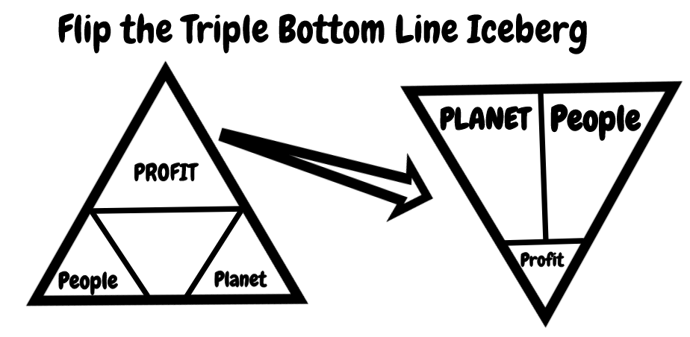

Slide 55
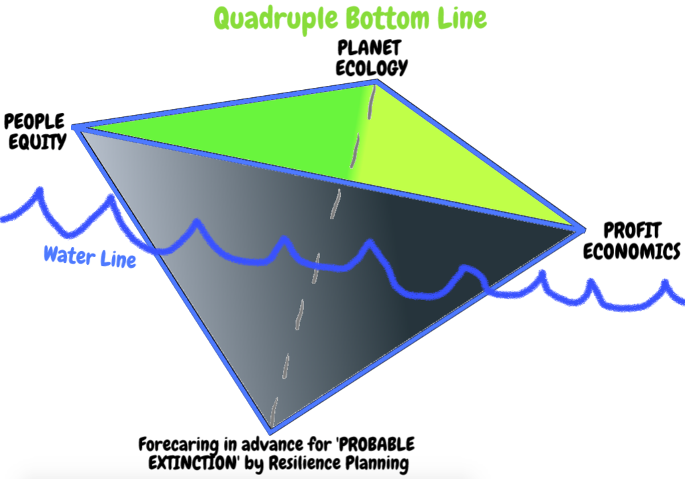
Bottom Line Extinction

Slide 56
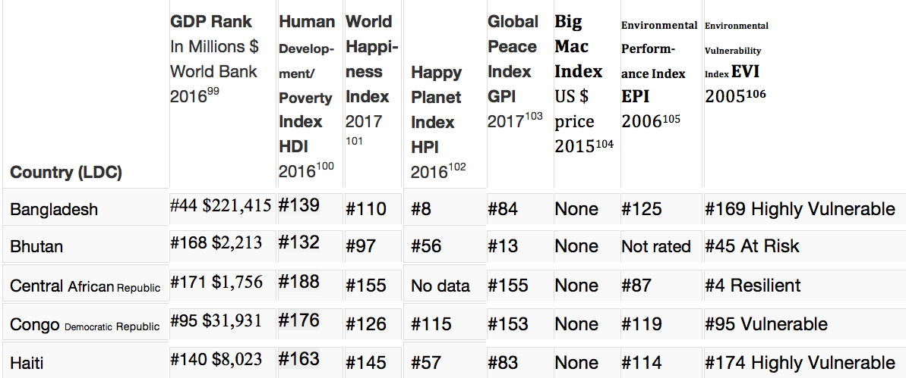
What about Less Developed Nations LDV’s

Slide 57
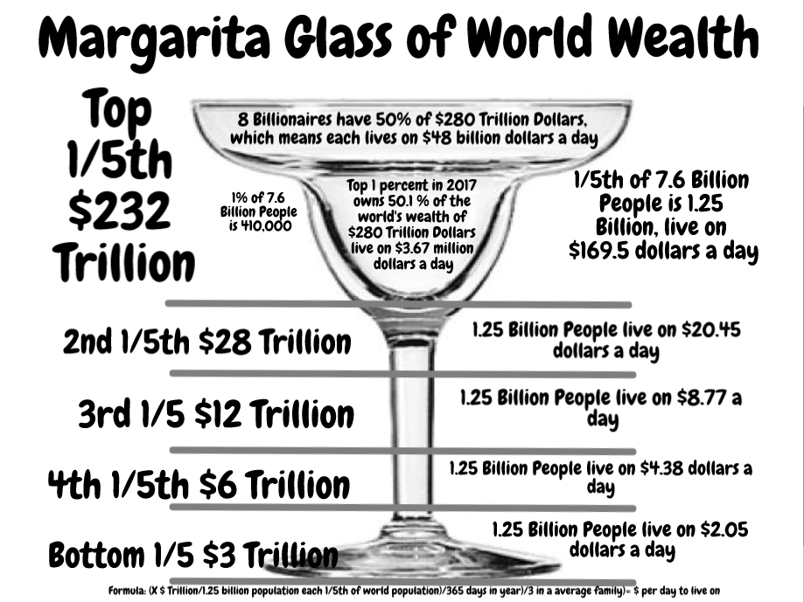
Hidden Cost of Globalization

Slide 58
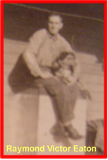
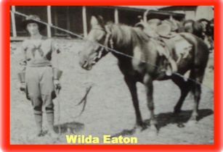
How Indigenous Celtic helps tame Globalization
My indigenous roots are Celtic on my mother’s side
Grandfather Raymond Victor Eaton [his lines included Canedy and Ramsdell]
Grandmother Wilda Shelton, my great grandfather Shelton, and great grandmother Virginia Tuttle (born Mar 13 1863; died Oct 11, 1944; her father Abraham Tuttle born in NC & died Jan 12 1883 [Abraham Tuttle’s father was Benjamin Tuttle, & mother Gatesy E. Fox born 1790 in Cook County, NC & died 1886 at 116 years of age; Virginia Tuttle’s mother Lucinda Davis died Feb 15 1884; Lucinda Davis’ mother Delilah McGee from Ireland, and father of Lucinda Davis was Thomepram Davis (More)

Slide 59
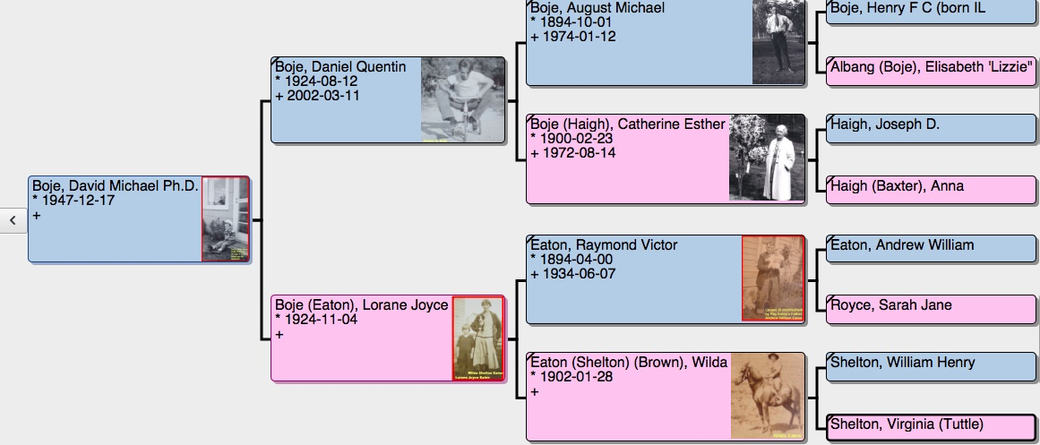
My Ancestral Living Story

Slide 60
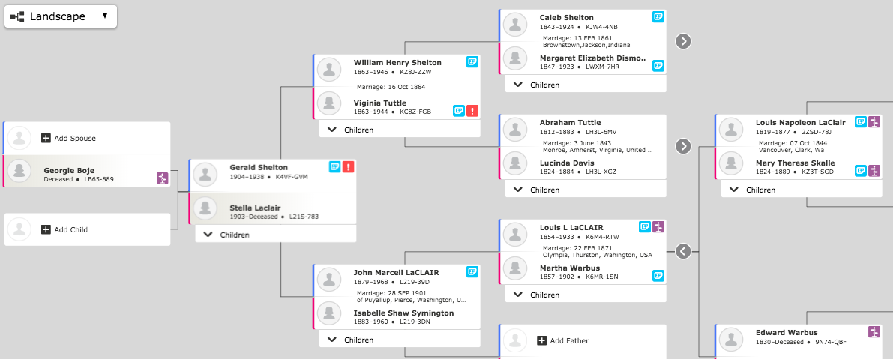
Boje’s Deeper Indigenous Roots
CELTIC ROOTS

Slide 61
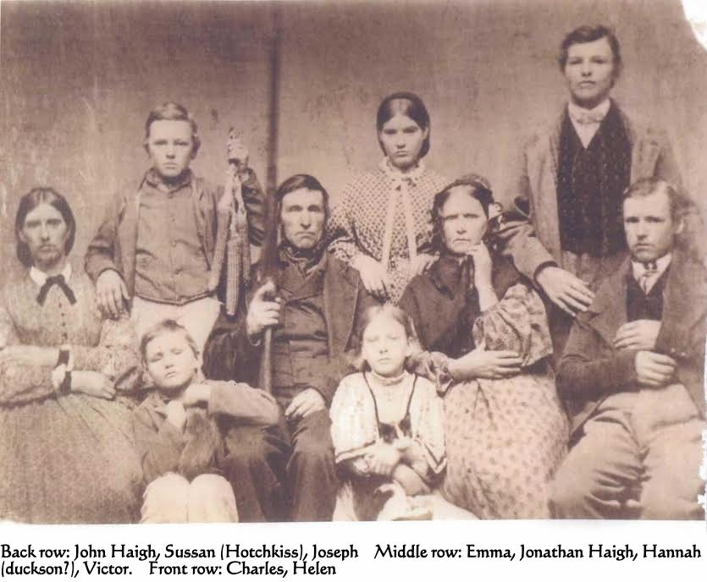
Dad’s side

Slide 62
Short Answers
One version of globalization is being replaced by another, and another
The 6th Extinction is underway, but is not something human species will likely recover from
New Zealand, Scotland and Denmark are smaller advanced capitalist countries able to find economic success. New Zealand is bi-cultural, while Scotland and Denmark are culturally Celtic, in part
Other countries not recovering from globalization depletion of natural resources, pollution of water, soil degradation…

Slide 63
Questions
Can Milan challenge globalization today before Planetary Boundaries are reached?
Is Italy’s economic quarrel with the newest waves of globalization?
How can Italy maintain its cultural identity, while remaining part of Globalization?
Notes:
See Vinnarei & Laine (2017) The moral mechanism of counter accounts: The case of industrial animal production. Accounting Organizations and Society. Vol. 57: 1-17.

Slide 64
If Globalization is Unsustainable Climate Change, then what is Scotland doing?
What does sustainability mean?
What is to be sustained?
For how long?
In whose interests?
“Most so-called ‘sustainability’ reports simply ignore such questions …” (Milne, 2013: 136)
Notes:
Milne, Markus J. (2013). Phantasmagoria, sustain-a-babbling in social and environmental reporting. Pp. 135-153 in Lisa Jack, Jane Davison, Russell Craig (Eds.) The Routledge companion to accounting communication. NY: Routledge.

Slide 65
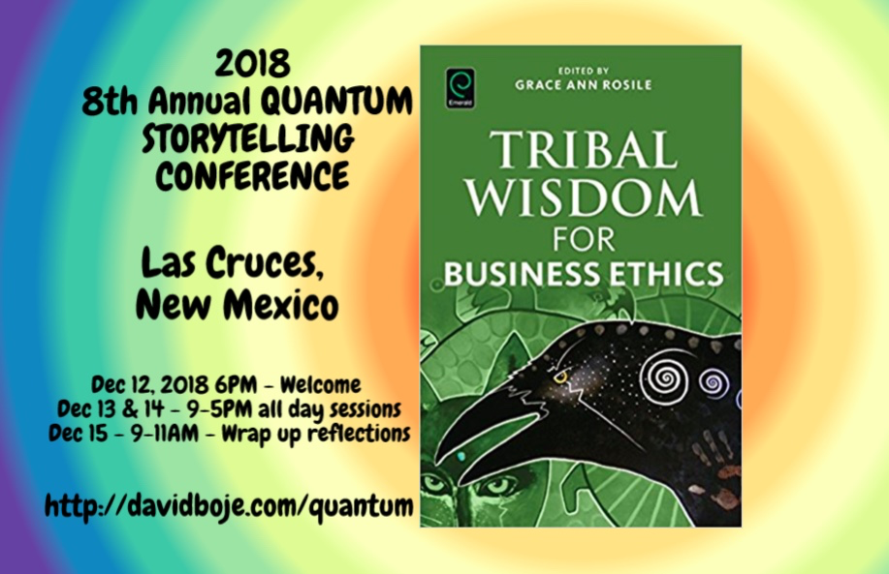
STOP HERE
Question & Answers
Thank you
Milan Storytelling Seminar
Slides & books at http://davidboje.com/Italy

Slide 66
Corporate Social Responsibility (CSR) is just PR Narrative
Globalization throughout the 1970s and 80s meant loss of manufacturing jobs, and in 2000’s downsizing of finance and insurance jobs.
This resulted in pressure for CSR of multinational corporations, that are bigger than many countries.
But voluntary CSR is just a PR narrative without real enforcement of professed standards
An alternative is Worker-Driven CSR, such as Coalition of Immokalee Workers (CIW) movement to end agricultural slavery and sexual abuse.

Slide 67
What is a hidden cost? What to do about it?
Hidden Cost defined as UNSEEN costs hidden behind official accounting/budget/financial NARRATIVES & GREENWASHING NARRATIVES
COUNTER ACCOUNTING → defined as process of identifying & reporting HIDDEN COSTS of organizations’ significant economic, environmental & social Problems, covered over by POSITIVE NARRATIVE
HOW? Do QUALIMETICS (qualitative/quantitative/financial) research into external or unofficial sources (expert reports, research papers, online journals, studies from NGOs, government publications, legal proceedings, etc.) in view of verifying, to produce liberatory COUNTER ACCOUNTING with EMANCIPATORY POTENTIAL
Notes:
Boiral, Oliver. (2013). Sustainability reports as simulacra? A counter-account of A and A+ GRI reports. Accounting, Auditing & Accountability Journal, 26(7), 1036-1071.

Slide 68
ETHICS of INEQUALITY
Notes:
'Wealth: Having it all and wanting more'
Published 19 January 2015
Author: Deborah Hardoon, Senior Researcher, Oxfam GB
There were two main external data sources used:
1 - Credit Suisse Global Wealth Databook 2014
https://www.credit-suisse.com/uk/en/news-and-expertise/research/credit-suisse-research-institute/publications.html
Data was extrcated from the 2014 report and a STATA file which included revised calculations for global wealth and wealth shares dating back to 2000.
All data from Credit Suisse is highlighted in blue in this file

Slide 69
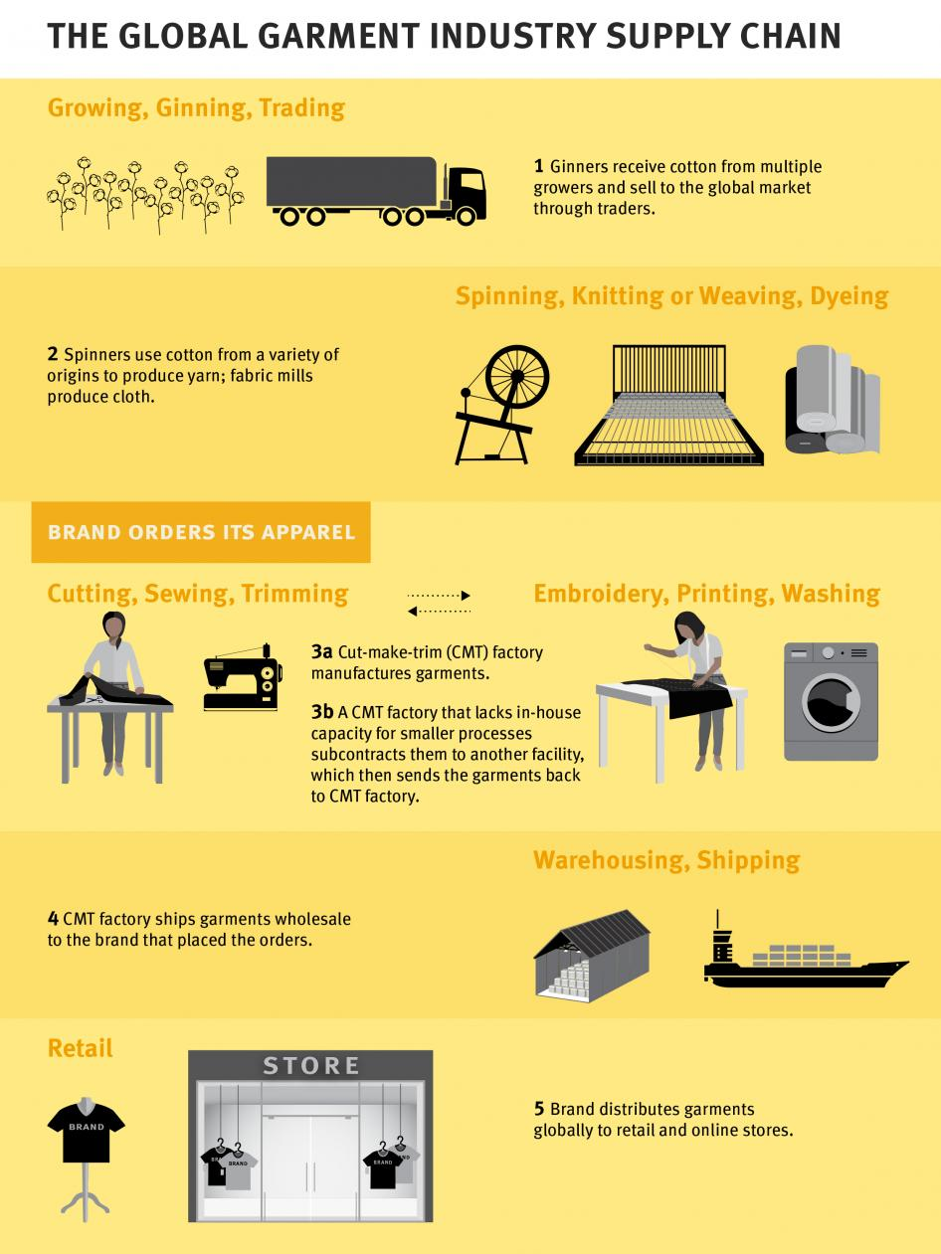

Slide 70
Below the Happy Planet Index-Iceberg

Slide 71
Bangladesh
Nike, Patagonia & H&M Group committed to adhere to transparency pledge. Others, such as Columbia Sportswear and the Walt Disney Co.also publish names and addresses of supplier factories, acknowledge 2017 NGO report moving ‘in the right direction.’ But companies listed in the ‘No Commitment to Publish Supplier Factory Information’ category include Hugo Boss, Mango and Wal-Mart (NPR 2017)

Slide 72
Living story of Central African Republic
Notes:
In the Central African Republic, this living story in a web of living stories. Pregnant at the time, Rosen Moseba fled her home, as Seleka (Muslim) rebels went door to door in 2013. She was caught by armed rebels: “Three of them raped me, one by one. After they raped me some of the Seleka said, ‘Let’s kill her’. Others said, ‘No, no we are not going to kill her, we have already done what we want to do’ … ‘I tried to resist but I couldn’t do anything because they had guns, and I had nothing’” Her children and her brother were killed in front of her. People such as Rosen are in crisis, with no housing, no livelihood to pay rent or pay for children to go to school. Her husband left her, went he found out she had been raped.
Five yeas since 2013 and the rapes of Rosen Moseba, half the population needs humanitarian assistance, and more than a million have been uprooted by the fighting. The capital is under government control but throughout CAR relations of Muslims and Christians is tense and the crisis worsened over past 12 months.
In terms of ecology, armed groups compete for natural resources, in a lawless context of ethnic and religious rivalries. Humanitarian space is shrinking, with fewer and fewer people having access, while conflicts worsen and children know the noise of guns. Rosen Moseba says “It’s very difficult” … “I am afraid I am going to be evicted from my house and my children don’t go to school… Before the crisis I used to sell things, not now I have lost everything and I don’t have enough money to start another activity … Because I am an orphan and I have no one to help me, it is very difficult. The future is very dark now”.
https://www.theguardian.com/global-development/2017/dec/18/the-future-is-very-dark-central-african-republics-relentless-cycle-of-suffering

Slide 73
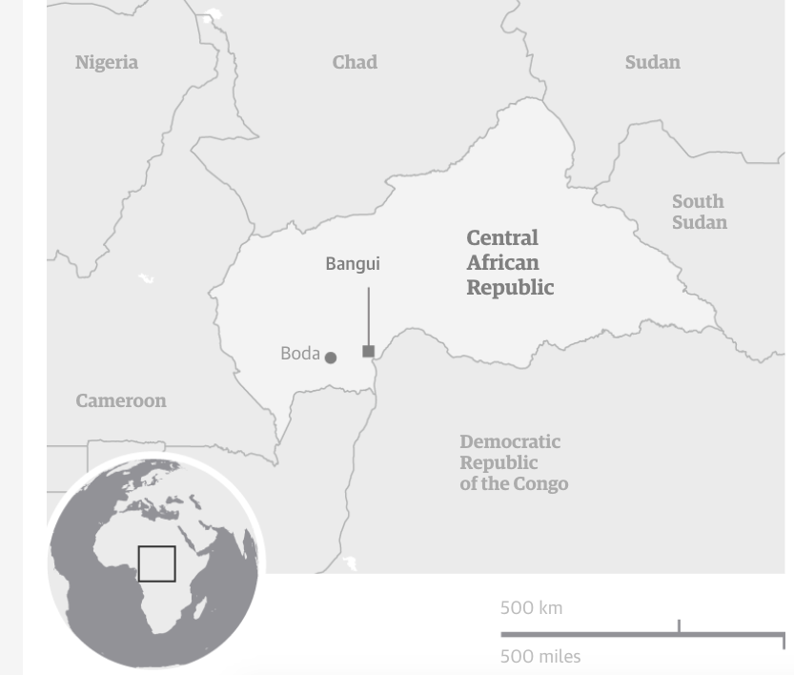

Slide 74
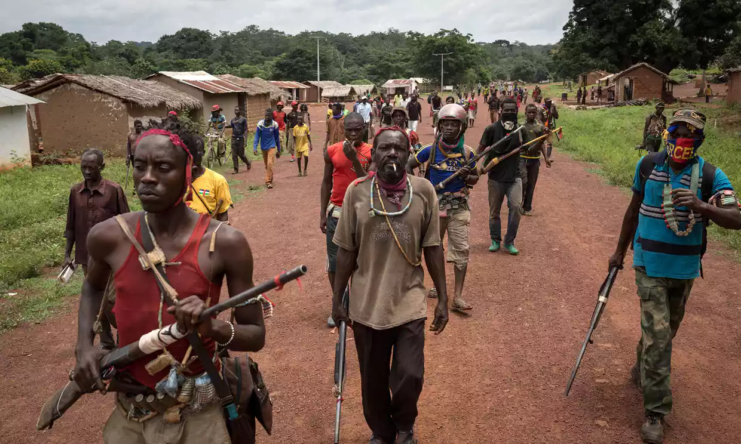
Notes:
Looting, escalating violence, and more death by rival rebel groups in CAR, as aid organizations withdrew at height of malaria season. One result is women are denied a safe place to give birth. Armed rebels entered a hospital where 7,000 sought refuge, and killed a baby held by its mother. 6 Red Cross volunteers were hilled in an attack on a health center. Health workers have to negotiate with armed people to gain access to villages. Stephen O’Brien a UN emergency relief coordinator, said this is “the early warnings of genocide”.
'People are dying': violence forces aid workers out of Central African Republic, by Rebecca Ratcliffe
Fri 1 Sep 2017 06.04 EDT
Last modified on Mon 11 Dec 2017, accessed Feb 16 2018 at https://www.theguardian.com/global-development/2017/sep/01/people-are-dying-violence-forces-aid-workers-out-of-central-african-republic

Slide 75
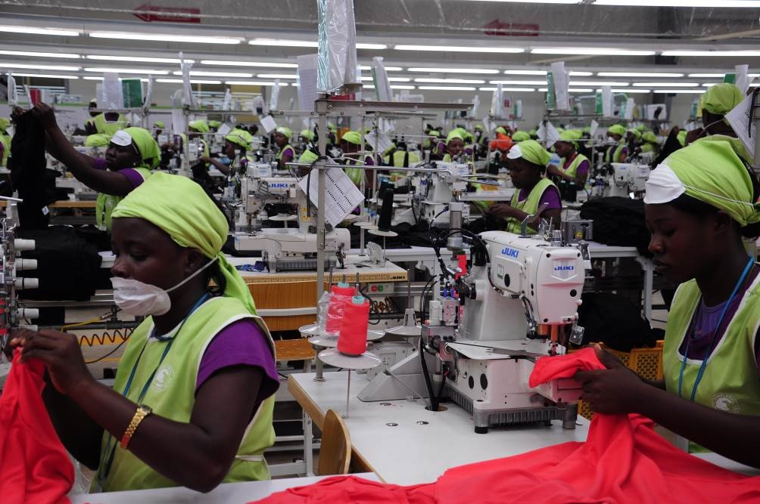
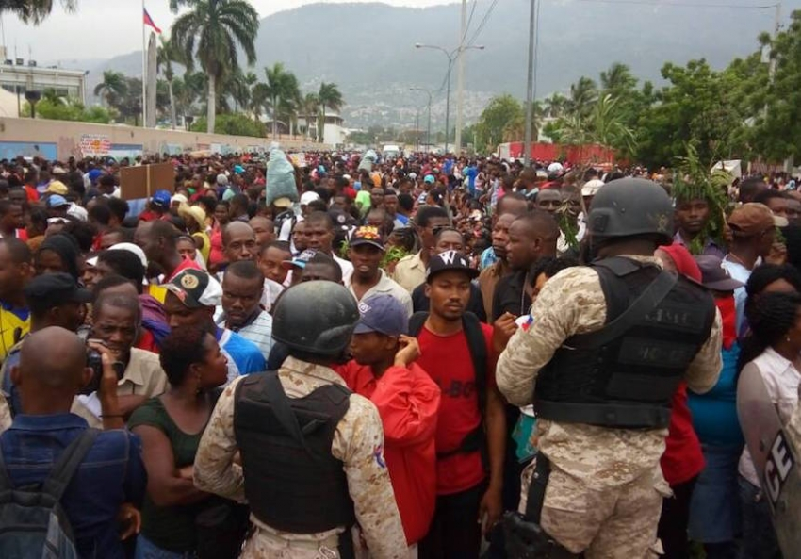
Globalization Sweatshops of Haiti
Notes:
May 19, 2017 thousands of sweatshop workers went on strike, shutting down dozens of textile factories, blocking the road to the International airport in Port-au-Prince, and marching toward the Presidential Place, until the riot police tear gassed the workers.

Slide 76
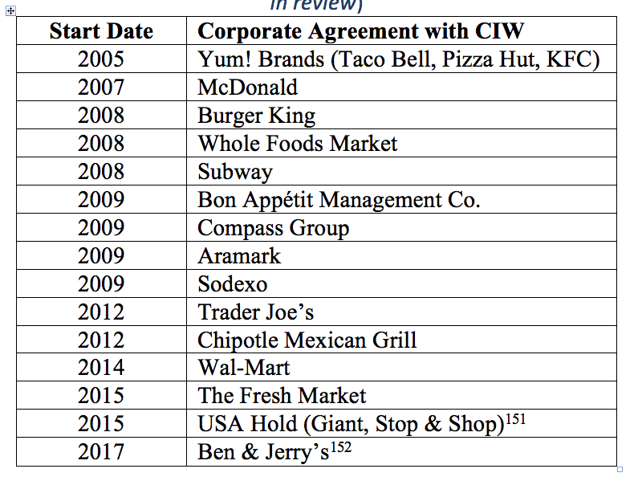
How to turn it around with worker-driven Corporate Social Responsbility

Slide 77
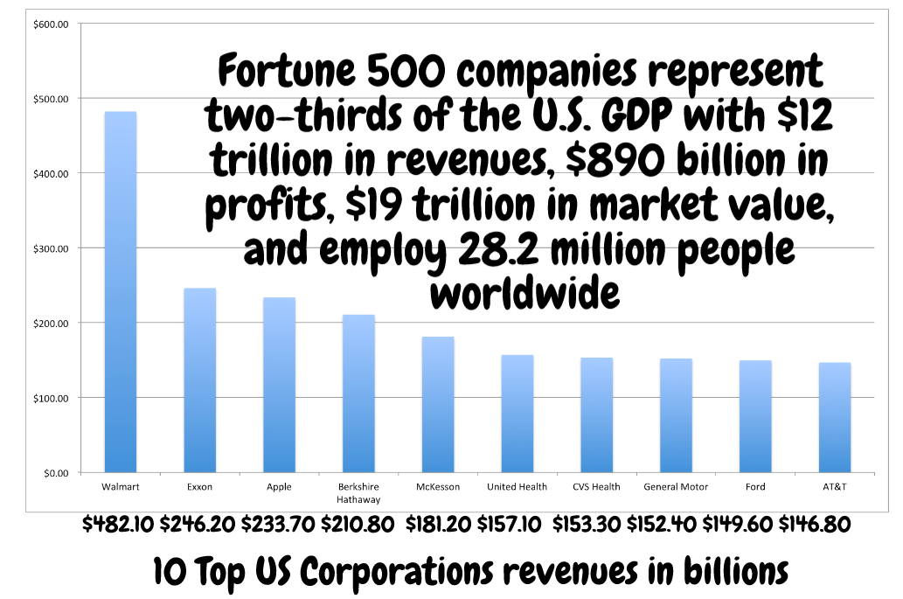
Are US Corporations Ethical?

Slide 78
US example
Farmers in India committing suicide, able to keep their farms due to fees payable to Monsanto when terminator seeds blow onto their land or are introduced by shady vendors

Slide 79
Worker-Driven “Corporate Social Responsibility’ ETHICS Example

Slide 81
How can you help end global slavery supply chain?
Worker education,
Worker-driven alliances, &
System of alliance of consumers, brands, growers, and workers
This creates revolutionary changes

Slide 82
Five Female Migrant Workers Awarded $17 Million In Rape, Harassment Case
The women claim their bosses assaulted them on the job.
By Laura Bassett

Slide 83
Sociomateriality of Modern-Day Slavery In USA
"The bosses carried weapons. They scared me. I never knew where I was. We were transported every fifteen days to different cities. I knew if I tried to escape I would not get far because everything was unfamiliar. The bosses said that if we escaped they would get their money from our families."
--Congressional testimony of Maria, trafficking survivor from Mexico
https://www.commondreams.org/views/2010/06/19/driven-globalization-todays-slave-trade-thrives-home-and-abroad

Slide 84
What are the Chemical Working Conditions”
Carlos Candelario, known as Carlitos, was born Dec. 17 without arms or legs.
At the entrance to the field where the mother worked, there is a list of some 30 chemicals used on the crops during the year
This is sociomateriality of storytelling.
Its an embodiment and dismemberment of the next generation
http://www.mypalmbeachpost.com/news/carlitos/

Slide 85
Naïve ‘Grand’ Narratives of Corporate Social Responsibility
Have you heard that U.S. corporations, such as Nike and Apple are socially responsible?
Vietnamese at Nike factory on outskirts of Ho Chi Minh City
Notes:
https://www.theguardian.com/news/2017/nov/06/nike-tax-paradise-papers

Slide 86
China Labor Watch report
You have heard that after years of worker protest and student action, Nike developed a Code of Conduct for its factories.
After Nike code of conduct introduced as this China factory, the pace of work has increased. Before the Nike code was applied, Nike had an overtime stipulation. After the code, workers have to finish a job in 10 hours that used to take 12 hours. This in effect increases working intensity - http://www.chinalaborwatch.org/report/7
A pair of Nike Jordan TYPE 15 Type shoes retails at US$130 in USA. Of this sum, less than US$1.5 goes to the workers who made the shoes.

Slide 87
Nike and Social Responsibility
NIKE “a story involving grey areas and loopholes, tax havens and zero tax rates, and the movement of money and royalties from one jurisdiction to the next” (Guardian, Nov 6, 2017).
Netherlands new tax structure allows Nike to move billions of dollars in profits from Europe to Bermuda
Notes:
https://www.theguardian.com/news/2017/nov/06/nike-tax-paradise-papers

Slide 88
Wal-Mart and Home-Depot
“The cost of Wal-Mart and Home Depot's low prices is exploited laborers working under extremely stressful and exhausting conditions. The enforcement of Wal-Mart and Home Depot's ethical sourcing standards at Cuori is a total failure" (China Labor Watch, Nov 29, 2016)

Slide 89
Nike pays less taxes by charging themselves for intellectual property
Notes:
https://www.theguardian.com/news/2017/nov/06/nike-tax-paradise-papers

Slide 90
Apple Computer Socially Responsible US Corporation
“Over the past three years, Apple has reported paying very low tax rates on its profits outside the US – not much more than previously. But this remains significantly lower than all the major markets where its phones, iPads and desktop computers are sold – and less than half the rate in Ireland, where the company has many of its subsidiaries” (Guardian, Nov 6, 2017).

Slide 91
Apple’s 50 Corporate Social Responsibility Audits
China Labor Watch (Jan 16, 2018). Reported Apple’s Catcher Technology Polluting the Environment and Harming the Health of Workers.
May 25 2017 an incident of toxic gas poisoning at Catcher’s A6 workshop resulted in the hospitalization of 90 workers. (China Labor Watch, Jan 16 2018).
China Labor Watch (CLW)”brought up a number of issues regarding Catcher with Apple
Apple claimed that the factory had undertaken and passed over 50 CSR audits
Notes:
China Labor Watch (Jan 16, 2018). Apple’s Failed CSR Audit : A Report on Catcher Technology Polluting the Environment and Harming the Health of Workers. Accessed Feb 6, 2018 at http://www.chinalaborwatch.org/upfile/2018_01_12/20180116-1.pdf

Slide 92
Apple’s 50 Corporate Social Responsibility Audits Failed to catch
Machine operators coming in contact with cutting fluid. Provided plastic gloves absorb a lot of chemical oil and fluids, and erode the plastic off the gloves. Workers’ bare hands make direct contact with remains of cotton glove, now soaked with cutting fluid, resulting in the skin around the hand becoming irritated and peeling off.
Excessive loud noise at the workshops of the CNC department, which can cause irreversible damage to workers’ hearing.
Ground’s surface covered in oil, resulting in workers slipping and falling.
Workers contact with toxic substances that factory does not specify what the chemicals are and the potential hazards
Many workers ill eating cafeteria food (hair in food).

Slide 93
Apple’s Sustainability Standards are a problem
China Labor Watch (CLW) seriously questions Apple's sustainability reporting. CLW finds “severe discrepancies between what Apple tells the public and its investors about the working hours of workers making its products and the reality on the production line”
Problems: Apple's monitoring and wages unsustainable.
“… despite being the most profitable company in history, Apple does not raise the bar to a commensurate level for workers making its products. They still earn minimum wage. They still depend on tremendous overtime to make ends meet.”
China Labor Watch (Feb 24 2016)

Slide 94
INTERACTIVE QUESTION: Is CSR a PR GAME?
Notes:
http://www.chinalaborwatch.org/report/107

Slide 95
Conclusion
“The combined base wages of 1.6 million workers on Apple’s supply chain only accounts for 2.6% of Apple annual revenues” $215.6 billion.
China Labor Watch (Feb 24, 2016). Study Casts Doubts on Apple’s Ethical Standards. Accessed Feb 6 2018 at http://www.chinalaborwatch.org/report/113

